Slide 1

Out with the Old
Activity 3

Slide 2
Today you will be designing something!
Notes:
Select one object for students to design in class. This may be a bubble wand, fidget device, or another comparable item.

Slide 3
Draw: Draw, or design, your item!
Notes:
Tell students to draw, or design, the item on a blank piece of paper.
Tell students that they are designing this item for “Junior STEM Challenge practice.” Students can create this item in class during the same class period, or it can be assigned as homework or completed in class the day before.
If students design the item in class, they will work with their Junior STEM Challenge groups. If students design their item as homework, they will work independently.

Slide 4
Share: What did you do to design your item?
Notes:
Exemplar Response: Student answers will vary.

Slide 5
Share: Do you think your design is finished? Why or why not?
Notes:
Exemplar Response: Our design is not finished yet because it still has a lot of room for improvement.

Slide 6
Share: Do you think that scientists and engineers are done solving a problem as soon as they come up with their first idea? Why or why not?
Notes:
Exemplar Response: Scientists and engineers are not done once they come up with an idea because they need to build, test, and improve their design several times before they are ‘done.’

Slide 7
Share: Can you think of at least one solution, item, or product that scientists and engineers have kept working on over time?
Notes:
Exemplar Response: Student answers will vary. For example: Engineers have kept improving cellphones over time. They did not stop at the first iPhone or android phone. Instead, they kept making new, better versions.

Slide 8
Brainstorm: Brainstorm the steps engineers may use in their engineering design process on sticky notes
Notes:
Tell students that during the Junior STEM Challenge, the first idea they come up with will not be perfect and will still need more work. Engineers and scientists use the engineering design process to make their ideas better and better over time.
Give each group of students a stack of sticky notes. Tell students to work with their group to brainstorm the steps engineers may use in their engineering design process. Remind students that they have already completed some of these steps during this activity and other Junior STEM Challenge activities. The first step of the engineering design process is “identify a problem” and the last step is “share their idea.” Groups should try to come up with 2-8 more steps (for a total of 4-10 steps) of the engineering design process, writing each step on a separate sticky note.
As students brainstorm additional steps to the engineering design process, circulate the classroom and make sure that students have written “identify a problem” and “share their idea” on two separate sticky notes.

Slide 9
Organize: Put your stickynotes in order! Use arrows if needed.
Notes:
Once students have recorded each step on their sticky notes, tell students to organize the sticky notes into their engineering design process. If students want to, they can draw arrows on additional sticky notes to help show the direction of the engineering design process.
As students organize each step into the engineering design process, take note if it looks linear or cyclical.

Slide 10
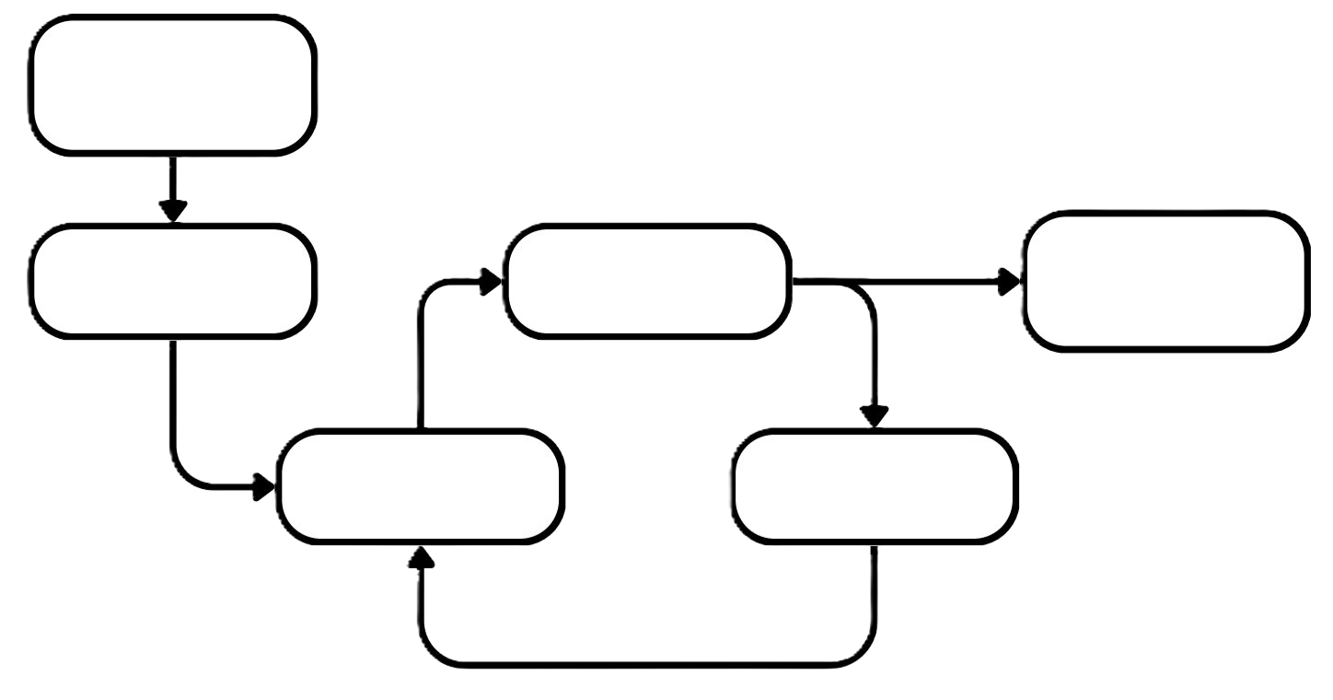
Real World Problem
Plan
Test
Communicate Solution
Prototype
Redesign
Notes:
Once students have organized their sticky notes, write or project the following engineering design process on the board. As you read out each step of the process, tell students to raise their hands if they included that step on their sticky notes.
Tell students to open their Student Guidebooks to the “Out with the Old” student activity sheet and record each step of the engineering design process.

Slide 11
Share: Besides the steps, what else do you notice about this process? How is it shaped?
Notes:
Exemplar Response: The process is a cycle that can repeat over and over again.

Slide 12
Share: Why do you think this process is a cycle and not a straight line?
Notes:
Exemplar Response: The process is a cycle because there will ways to improve on an idea and make it better.

Slide 13
The engineering design process does not have a clear end!
Notes:
Tell students that like they talked about earlier, scientists and engineers keep working on their ideas over time, even if their idea is being used already. There is not a clear end to the engineering design process, just a place where people choose to share their idea with others. Also, even if scientists and engineers stop working on an idea, other people can pick up where they left off, continuing the engineering design process.

Slide 14
Write: Label your design
"Version 1"
Notes:
Tell students that to practice the engineering design process, they will be working on the item that they designed at the start of this activity. This item is going to be their “prototype.” Students should pull out the paper where they designed their item and label it “Version 1.”
If students designed their item as homework, tell each Junior STEM Challenge group to identify one of their items to use for the rest of the activity. While each group must pick one item, students can add elements from the rest of their items during their first redesign.

Slide 15
Share: A prototype is an early version of an item that we can test to see if it works. Is your item a prototype we can test? Why or why not?
Notes:
Exemplar Response: Our item is not a prototype because it is not a physical item we can test.

Slide 16
Share: What do we have in place of the prototype for the Junior STEM Challenge?
Notes:
Exemplar Response: We have a model instead of a prototype.

Slide 17
Share: What is the next step of the engineering design process?
Notes:
Exemplar Response: The next step of the engineering design process is testing our prototype, item, or solution.

Slide 18
Share: Do you think you will be able to test your item during this activity and test your solution during the Junior STEM Challenge?
Notes:
Exemplar Response: No, we will not be able to and do not need to test our items and solutions.

Slide 19
Share: If we cannot test our item or solution, what else can we do to make sure our item works?
Notes:
Exemplar Response: Instead of testing our item or solution, we can look for information that shows our item or solution can work. This could be research articles or examples of previous items and solutions that worked.

Slide 20
Research: Look up similar items!
Notes:
Tell students to use their computers to look up other ways that creators have designed similar items. As students look at each item, they should look for what works and identify any design characteristics that are similar between the items. Tell students to record these elements in the designated spot in their Student Guidebook.
Give students at least 5 minutes for this part of the activity.

Slide 21
Share: Why do you think these items all share the same characteristics?
Notes:
Exemplar Response: They share these characteristics because these characteristics help the items work. The characteristics may also make the items cheaper or look nicer than alternative designs.

Slide 22
Share: If these items all share several characteristics, why do they look different?
Notes:
Exemplar Response: Student answers will vary. For example: The items look different because they were made for different people or groups or because people would not buy them if they all looked the same.

Slide 23
Share: How can you use some of the same characteristics, but still make your design unique?
Notes:
Exemplar Response: Student answers will vary.

Slide 24
Write: In your guidebook, create a list of things you might want to add to your design.
Notes:
Tell students to use the space following the table in their guidebook to describe how they can add some of the characteristics they think would be helpful into their design while still keeping their design unique.
Give students at least 5 minutes to develop an implementation plan.

Slide 25
Draw: Label a new piece of paper "Version 2." Using the list you created, draw your new, updated design!
Notes:
Tell students to take the changes they described and draw an updated version of their design on a new sheet of paper. They should label this new design, “Version 2.”

Slide 26
Create a final product that shows off your design!
Notes:
Students will only have time to create one of the following final products in class: the Scale Drawing, Digital Model, or Physical Model. Creating a Scale Drawing is more challenging than creating a digital or physical model, so it is only recommended for advanced 7th grade classes and 8th grade classes.
If students are creating a digital or physical model in class, tell students that they will not be using the Scale Drawing section of the activity in their Student Guidebook. Students only need to use this section if they are completing a Scale Drawing.
Optionally, students can create additional final products in the following class period or can be directed to create additional final products as homework. If students are creating more than one type of final product, students should be completing the final products in alphabetical order (e.g. a digital model before a physical model).
Give students 20 minutes for this part of the activity.
Use the instructions provided in the Teacher Guidebook to help students create their final products.

Slide 27
Share: Why is it important that you looked over your item a few times before creating your final product?
Notes:
Exemplar Response: Student answers will vary. For example: It takes a lot more effort, time, and materials to create a Scale Drawing/ Digital Model/Physical Model than it does to create an initial design. By revising a few times before making the Scale Drawing/Digital Model/Physical Model, we can make sure we are putting our effort into making something that we feel good about.

Slide 28
Share: Can you still improve on your version 2 design? Why or why not?
Notes:
Exemplar Response: We can still improve on our version 2 design because there are still places where things might not work the way we want them to. Our item is also not super unique, so we need to keep working on it so that it stands out from similar items.

Slide 29
Share: Did your version 2 design look the same as your final product? Why or why not?
Notes:
Exemplar Response: Student answers will vary. For example: Our version 2 design looked slightly different from our Scale Drawing/ Digital Model/Physical Model because the measurements and size of some of our components changed.

Slide 30
Share: Was there anything you would change about your design after making your final product? Why or why not?
Notes:
Exemplar Response: Student answers will vary. For example: We would want to change the size of a few parts of our design so that they fit together better.

Slide 31
Draw: Label a new piece of paper "Version 3." Draw your new, updated design!
Notes:
Tell students to take 5 minutes to revise their design one last time on a new sheet of paper. These revisions should reflect any changes they made for their Scale Drawing/ Digital Model/Physical Model and want to keep. If there are any changes that students made that they do not like, they can revert those parts of their design back to a previous version. Tell students to label this paper, “Version 3.”

Slide 32
Share: Can you still improve your version 3 design? Why or why not?
Notes:
Exemplar Response: Student answers will vary. For example: We can still improve our version 3 design. If we have time, we would want to model it again to see if our changes made our item better. We may want to model and redesign the item a few more times before we are completely happy with it.

Slide 33
Share: Did creating a final product teach you anything about your design? How did it help?
Notes:
Exemplar Response: Student answers will vary. For example: When we created our Scale Drawing/Digital Model/Physical Model we noticed a few design flaws that would have kept our item from working. It also left us with a few questions about how some components were attached to each other. This helped us figure out some things we might need to change.

Slide 34
Share: Why do you think we spent class practicing the redesign step of the engineering design process? How could this practice be helpful for the Junior STEM Challenge?
Notes:
Exemplar Response: Redesigning our item or solution is an important part of the engineering design process. By practicing the redesign step, we are practicing analyzing our item or solution and looking for things that could be fixed or otherwise improved. Doing this in the Junior STEM Challenge will help us make our solutions even better.

Slide 35
Redesigning is a normal part of the engineering design process and Junior STEM Challenge!
Notes:
Tell students that in their Junior STEM Challenge projects, they will need to redesign their solutions several times. They may need to redesign it after learning something new about their problem, after modeling their problem, or after receiving feedback. While some of the changes they make might be small, other changes may be a bit larger and may take more time. In some cases, students might even come up with a completely new solution. It can be frustrating, but it is a very normal part of the process!

