Slide 1

Let's Get Started
Activity 1

Slide 2

Welcome to the STEM Challenge!

Slide 3
STEM Challenge Practice

Slide 4
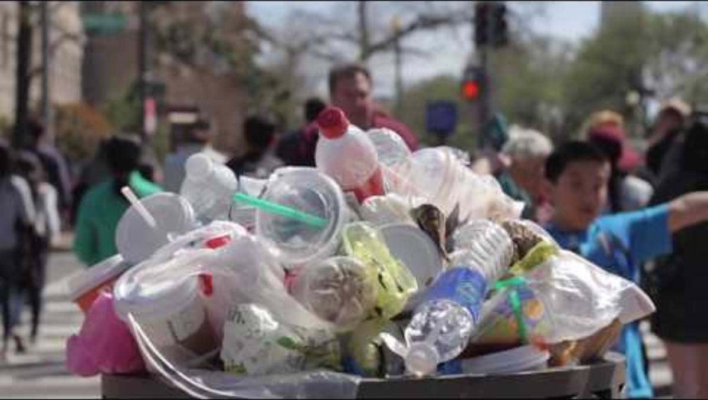
Practice: Microplastics
When plastics are discarded, they break down into microplastics. These microplastics can be found everywhere, from clouds to human blood. What is one issue caused by microplastics and how can we prevent or reduce the impacts of this issue?
Notes:
If the prompt used by your class for the Practice STEM Challenge is different from the recommended prompt, make sure that the prompt and associated information in the PowerPoint is changed before presenting it to your students.

Slide 5
Answer: Question 1
Use the Microplastic Fact Sheet and any other resources to learn more about microplastics during this time.
1) Identify at least five problems or issues that address the prompt. Be specific.
5
Time's Up!
4
3
2
1
Notes:
The five minute timer will begin upon click.

Slide 6
Answer: Questions 2-7
2) Brainstorm at least one solution for each of the problems you identified.
3) What problem/solution is the most practical and best addresses the prompt? Does this solution already exist? If so, how can you improve it to better address this issue?
4) How can this solution be implemented? Be as detailed as possible.
5) Who is responsible for implementing solutions for this issue? In other words, who are your stakeholders?
6) Describe the design of a physical model that represents or demonstrates this solution. Models may include fully functional devices, scaled/miniature replicas of the solution, or diagrams and illustrations of the solution that include a physical component. If you are struggling to design a model, go back and take a closer look at the problem/solution you selected.
7) How would this physical model help explain or demonstrate your solution? What would this model add to a presentation about your solution?
Notes:
Use the following questions to help students refine their answers:
How does this solution address the problem?
Why is this solution practical?
What does it mean for a solution to be practical?
How does this solution address the prompt?
What is a stakeholder?
What components does your model have?
Does your model have labels?
Do you have any physical components to accompany your diagram or illustration?
What type of physical display could show the solutions procedures or the outcome of your solution?

Slide 7
STEM Challenge Practice Debrief

Slide 8
Answer: Questions 1-5
1) What was the most challenging part of creating a solution for the provided prompt? Why?
2) Why is it important to brainstorm more than one issue and solution associated with the prompt?
3) What are the advantages of brainstorming more than one solution for each issue?
4) What is the importance of explaining every detail behind the implementation of your solution? Why is it important to be as specific as possible?
5) Why is it important to consider your stakeholders?

Slide 9
Discuss: Answers to Questions 1-5
4
Time's Up!
3
2
1
Notes:
The four minute timer will begin upon click.
To help guide the student discussion about the brainstorming process, use the following guiding questions:
How did you narrow down a broad topic and a wide breadth of information into solvable issues?
What might happen if you only brainstorm the solutions for one issue?
Why is it important to think about the scope/specificity of the issue you selected?
Why is it important to think about the scope/specificity of proposed solutions?

Slide 10
Answer: Questions 6-7
6) In this activity, you were asked to describe how you would model your solution to the provided prompt. What difficulties did you encounter in designing this model?
7) What challenges would you expect to encounter in creating the model you designed? Think of the time and materials required to create your model.

Slide 11
Discuss: Answers to Questions 6-7
5
Time's Up!
4
3
2
1
Notes:
The five minute timer will begin upon click.
To help guide the student discussion, use the following guiding questions:
What is a model?
Did you have to go back and change what problem/solution combination you selected to create a model? Why?
What components did you feel your model had to include?
Why is it important to think of the time needed to create the model?
Why is it important to consider the materials required to create the model?
What would an “unsatisfactory” model look like?
What would an “exemplary” model look like?

Slide 12
Answer: Questions 8-9
8) How did the issues and solutions to the prompt vary from person to person?
9) What are the advantages of having a lot of people brainstorm the same prompt?

Slide 13
Discuss: Answers to Questions 8-9
Time's Up!
3
2
1
Notes:
The three minute timer will begin upon click.
To help guide the student discussion, use the following guiding questions:
How are people different in the ways they solve problems?
How do you approach problems? (Note: Several students should be asked this question.)
How can disagreement be a good thing?
Why do engineers work in groups?

Slide 14
STEM Challenge Preparation
Get Ready!

Slide 15
Answer: Questions 1-3
1) Review the STEM Challenge prompts. Which prompt interests you the most? Why?
2) You can work individually or in a group for the STEM Challenge. What are the advantages and disadvantages of working in a group? What are the advantages and disadvantages of working alone?
3) What does your workload look like this year? How much time do you have to dedicate to this project?

Slide 16
Share: Answer to Question 2

Slide 17
Answer: Question 4
4) Identify whether you would like to work individually or in a group. If you want to work in a group, find your group members now. Groups should be no larger than four students.
If you want to work in a group, find your group members now!

Slide 18
Answer: Questions 5-6
5) Select one prompt to complete for this year's STEM Challenge. If working in a group, make sure all group members agree with the prompt selection.
6) In your guidebook, turn to page 44 to propose a project timeline, record group member names, and optionally delegate tasks amongst group members.

Slide 19
Start the STEM Challenge!

